Slide 1


Sales Performance Overview
Discounts & Increasing Profits
2011 - 2014

Slide 2
Agenda
Introductions
Regional Discount Overview
Top 10 Highest Discounted States
Analyst
Strategy
End

Slide 3

Tommy Ramey
Logistics
Data Analytics
Morale Officer
Data Entry
Customer Service
BusinessEmail@AOL.COM
(555)-555-5555
LinkedIn

Slide 4
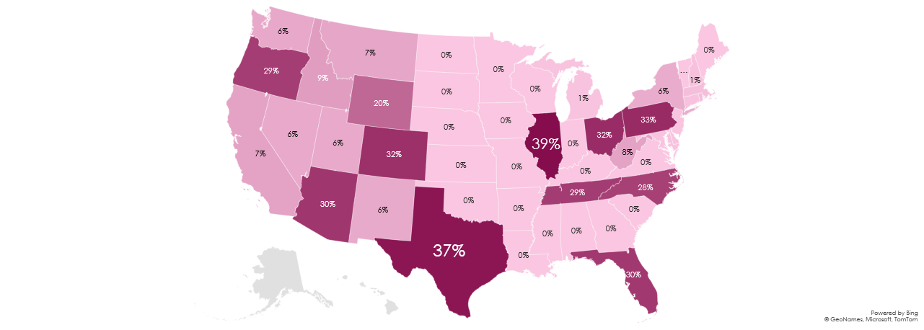
Regional Discount Averages
Unbalanced regional discounts.
Central Region lacking in discounts.

Slide 5
State | Profits | Average Discount
Illinois | $-12,607.88 | 39%
Texas | $-25,729.35 | 37%
Pennsylvania | $-15,559.96 | 33%
Ohio | $-16,971.37 | 32%
Colorado | $-6,527.85 | 32%
Arizona | $-3,427.92 | 30%
Florida | $-3,399.30 | 30%
Tennessee | $-5,341.69 | 29%
Oregon | $-11,90.47 | 29%
North Carolina | $-7,490.91 | 28%
Grand Total | -$98,246.74 | 34%
Top 10 Highest Discounted States & Profits

Slide 6
Discount vs Profit
Large Discounts lead to steep losses.
Discounts between 6%-9% yield highest profits

Slide 7
Conclusion

Slide 8
Analysis
Discounts over 10% lead to profit loss.
Discounts between 5%-10% return highest profits.

Slide 9
Strategy
Overhaul regional discount program.
01
Immediately reduce all discounts to below 10%
02
Roll out Central Region discount program.
03
Create a 10% Maximum Discount Policy.
04

Slide 10
The End
Thank you

